Slide 1
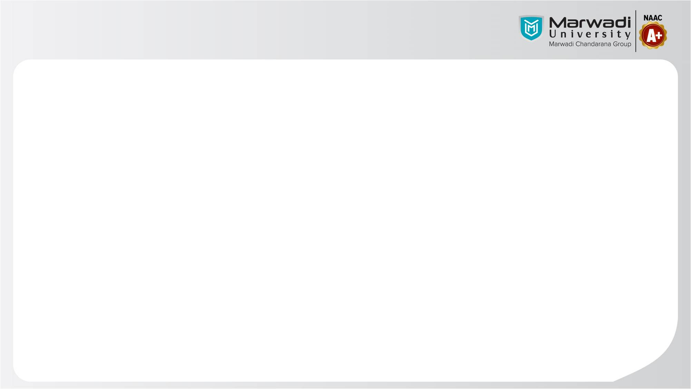

Department of Computer Engineering
Object Oriented Design and Programming (01AI0403)
Unit – 9
Templates & Exception Handling

Slide 2
Department of Computer Engineering
OUTLINE
What is template?
Function templates and class templates
Overloading Template Functions
Introduction to Exception Handling
try-catch throw
Multiple catch
catch all
Re-throwing Exception

Slide 3
Department of Computer Engineering
What is template?
C++ templates are a powerful feature of the C++ programming language that allows for generic programming (Supports any type of datatypes).
Templates provide a way to define generic classes or functions that can work with different data types without sacrificing type safety or performance.
Templates allow you to define parameterized types or functions, where one or more types can be specified as parameters.
These parameters can be used to define variables, classes, or functions that can work with any type specified when using the template.

Slide 4
Department of Computer Engineering
What is template?
Template allows developing reusable software components such as functions, classes, etc supporting different data types in a single frame work.
A template have 2 different types. They are,
Function templates
Class templates

Slide 5
Department of Computer Engineering
Function template
A function template specifies how an individual function can be constructed.
When defining a function template, you specify the function's signature and behavior using placeholders called type parameters or template parameters.
These parameters represent generic types and can be used throughout the function's code.
The actual types are determined when the function template is called with specific types.

Slide 6
Department of Computer Engineering
Function Template
Syntax:
template <typename T>
return type functionname(T arg1,T arg2)
{
//function body;
}

Slide 7
Department of Computer Engineering
Function Template - Example
#include <iostream>
using namespace std;
template <typename T> //support any type of data types
void swapNumbers(T& a, T& b)
{
T temp = a;
a = b;
b = temp;
}
int main() {
int num1 = 5, num2 = 10;
cout << "Before swapping: num1 = " << num1 << ", num2 = " << num2 << endl;

Slide 8
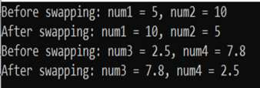
Department of Computer Engineering
// Swapping numbers using the function template
swapNumbers(num1, num2);
cout << "After swapping: num1 = " << num1 << ", num2 = " << num2 << endl;
double num3 = 2.5, num4 = 7.8;
cout << "Before swapping: num3 = " << num3 << ", num4 = " << num4 << endl;
// Swapping numbers using the same function template
swapNumbers(num3, num4);
cout << "After swapping: num3 = " << num3 << ", num4 = " << num4 << endl;
return 0;
}

Slide 9
Department of Computer Engineering
Class template
A class template in C++ is a blueprint for creating generic classes that can work with different data types.
It allows you to define a class that can be customized to work with various types without having to rewrite the class code for each type.
The syntax for defining a class template is similar to that of a regular class, with the addition of one or more type parameters enclosed in angle brackets (<>).
These type parameters represent generic types and can be used throughout the class definition.

Slide 10
Department of Computer Engineering
Class template
Syntax:
template <class T>
class classname
{
private:
T member1;
T member2;
…
public:
T fun();
…
};
objects for class template is created like:
classname <datatype> obj;
Variable and function can be accessed like:
obj.variable;
obj.memberfunction();

Slide 11
Department of Computer Engineering
Class Template – Example
#include <iostream>
using namespace std;
template <typename T>
class Swapper
{
private:
T a;
T b;
public:
Swapper(T a, T b) : a(a), b(b) // directly initialize using constructor argument
{
// this->a = a;
// this->b = b;
}

Slide 12
Department of Computer Engineering
Class template – Example
void swapNumbers() {
T temp = a;
a = b;
b = temp;
}
void displayNumbers() {
cout << "a = " << a << ", b = " << b << endl;
}
};
int main() {
Swapper <int> intSwapper(100, 20);
cout << "Before swapping: ";
intSwapper.displayNumbers();

Slide 13
Department of Computer Engineering
Class template – Example
// Swapping numbers using the class template
intSwapper.swapNumbers();
cout << "After swapping: ";
intSwapper.displayNumbers();
Swapper<double> doubleSwapper(2.5, 7.8);
cout << "Before swapping: ";
doubleSwapper.displayNumbers();
// Swapping numbers using the same class template
doubleSwapper.swapNumbers();
cout << "After swapping: ";
doubleSwapper.displayNumbers();
return 0;
}

Slide 14
Department of Computer Engineering
Overloading function templates
You may overload a function template either by a non-template function or by another function template.
When you call an overloaded function template, the compiler follows these steps:
It tries to figure out the correct data types for the template.
If successful, it creates a specialized version of the template.
It adds this specialized function to the list of possible functions.
How the compiler chooses the function to call:
If a regular function matches exactly, it will be chosen before the template.
If no exact match is found, the best template match is used.

Slide 15
Department of Computer Engineering
#include <iostream>
using namespace std;
// Function template
template<class T>
void f(T x, T y) {
cout << "Template" << endl;
}
// Non-template (regular) function for two integers
void f(int w, int z) {
cout << "Non-template" << endl;
}
// Overloaded non-template function for mixed types (int, char)
void f(int w, char z) {
cout << "Non-template" << endl;
}
int main() {
f(1, 2); // Calls f(int, int) → Non-template function
f('a', 'b'); // Calls f<char, char> (template function) → Template
f(1, 'b'); // Calls f(int, char) → Non-template function
}
Output :
Non-template
Template
Non-template

Slide 16
Department of Computer Engineering
Exception Handling – Introduction
Errors are the problems that occur in the program due to an illegal operation performed by the user or by the fault of a programmer.
Exception Handling is the process of handling errors and exceptions such that the normal execution of the system is not halted.
Exception handling in C++ consists of three keywords namely- try, catch, and throw.

Slide 17
Department of Computer Engineering
Exception Handling
Errors in C++
Errors are the problems that occur in the program due to an illegal operation performed by the user or by the fault of a programmer, which halts the normal flow of the program.
Errors are also termed bugs or faults.
There are mainly two types of errors in programming. They are,
Compile Time Errors
Run-Time Errors

Slide 18
Department of Computer Engineering
Exception Handling
Compile Time Errors
Compile Time Errors are those errors that are caught during compilation time.
Some of the most common compile-time errors are,
Syntax errors
Library references
Incorrect import of library functions and methods
Uneven bracket pair(s), etc.

Slide 19
Department of Computer Engineering
Exception Handling
Run-Time Errors
Run-Time Errors are those errors that cannot be caught during compilation time.
As we cannot check these errors during compile time, we name them Exceptions.
Exceptions can cause some serious issues so we should handle them effectively.
We use the exception handling in C++ is to separate the error handling code from the normal code. For exception handling in C++, we use the try-catch finally block.

Slide 20
Department of Computer Engineering
Exception Handling
Syntax:
try
{
throw exception; // Block of code to try
}
catch ()
{
// Block of code to handle errors
}

Slide 21
Department of Computer Engineering
Exception Handling
Why Exception Handling?
Exception handling in C++ separates error handling code from normal code to ensure that the normal execution of the program is not interrupted by errors or exceptions.
Unlike using multiple if-else conditions to handle errors, exception handling improves code readability and maintainability by allowing developers to easily manage exceptional situations.

Slide 22
Department of Computer Engineering
Exception Handling
In C++, exception handling enables the creation of a hierarchy of exception objects, grouping exceptions in namespaces or classes, and categorizing exceptions according to their types.
Using exception handling in C++, we can throw any number of exceptions from a function but we can choose to handle some of the thrown exceptions.
A program can throw both pre-defined as well as a custom exception(s) as per the need of the program.

Slide 23
Department of Computer Engineering
Hierarchy of Exceptions
Just like organizing things into folders on your computer, you can group different types of exceptions together based on what went wrong. This makes it easier to handle them separately.
Throwing Exceptions: When something goes wrong in your code and you want to say, "Hey, I hit a problem here!", you can throw an exception. You can throw as many of these as you need from a function.
Handling Exceptions: Now, just because you threw an exception doesn't mean you have to deal with it right away. You can choose to handle some exceptions and ignore others for now. It's like saying, "I'll deal with this problem later."
Pre-defined and Custom Exceptions: You can create your own types of errors that fit your program perfectly. So, if you're writing a game and you want to have a specific error for when the player runs out of lives.

Slide 24
Department of Computer Engineering
Exception Handling
try
The try block is used to keep the code that is expected to throw some exception. Whenever our code leads to any exception or error, the exception or error gets caught in the catch block.
In simple terms, we can say that the try block is used to define the block of code that needs to be tested for errors while it is being executed.
Example:
Suppose we are dealing with databases, we should put the code that is handling the database connection inside a try block as the database connection may raise some exceptions or errors.

Slide 25
Department of Computer Engineering
Exception Handling
Catch
The catch block is used to catch and handle the error(s) thrown from the try block.
If there are multiple exceptions thrown from the try block, then we can use multiple catch blocks after the try blocks for each exception.
In this way, we can perform different actions for the various occurring exceptions.
Catch block is used to define a block of code to be executed if an error occurs in the try block.

Slide 26
Department of Computer Engineering
Exception Handling
Example:
Let us take the same above example that we are dealing with the database.
Now, if during the connection, there is an exception raised inside the try block, then there should be a catch block present to catch or accept the exception and handle the exception.
The catch block ensures that the normal flow of the code is not halted.
Note:
The try and catch block comes is used in pairs.
We can have multiple catch blocks for one try statement.

Slide 27
Department of Computer Engineering
Exception Handling
throw
The throw block is used to throw exceptions to the exception handler which further communicates the error. The type of exception thrown should be same in the catch block.
The throw keyword accepts one parameter which is passed to the exception handler.
We can throw both pre-defined as well as custom exception(s) as per the requirements.
Whenever we want to explicitly throw an exception, we use the throw keyword. The throw keyword is also used to generate the custom exception.

Slide 28
Department of Computer Engineering
Exception Handling - Example 1
#include <iostream>
using namespace std;
//Here, we want to throw exception (age as exception) if the age of the person is less than 18
int main()
{
try // checking if the age is more than 18 in try block.
{
int age = 15;
if (age >= 18)
{
cout << "Access granted.";
}

Slide 29
Department of Computer Engineering
Exception Handling - Example 1
else // Throwing custom exception if the age is less than 18.
{
throw(age);
}
}
// catching the thrown exception and displaying the desired output (access denied!)
catch (int x)
{
cout << "Access denied!, Age is: " << x << endl;
}
return 0;
}

Slide 30
Department of Computer Engineering
Exception Handling - Example 2
#include <iostream>
using namespace std;
int division(int a, int b)
{
if (b == 0) // checking if the denominator is 0 or not.
{
throw "Division by zero!"; // if the denominator is 0, then we must throw an exception
} else{
return int(a / b); }// if there is no exception, then we are returning the answer.
}
int main()
{

Slide 31
Department of Computer Engineering
Exception Handling - Example 2
int x = 50, int y = 0, answer = 0;
/* Using a try catch block because in divison, the denominator can be 0. So, we must handle the 0 divion inside try block.*/
try {
answer = division(x, y);
cout << " Output: " << answer << endl;
}
catch (const char *errorMessage) // printing the thrown exception from the function
{
cout << errorMessage << endl;
}
return 0;
}

Slide 32
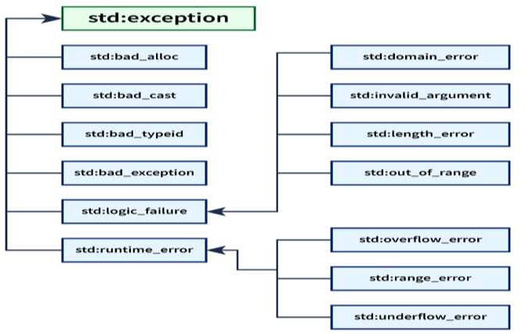
Department of Computer Engineering
C++ Standard Exceptions
The C++ library has some built-in standard exceptions under the <exception> header which can be used in our program.
The standard exceptions are arranged in a parent-child class hierarchy.

Slide 33
Department of Computer Engineering
C++ Exception Classes
class name | use case
std::exception | std::exception is the parent class of all the standard C++ exceptions. So, it contains declarations and definitions of other exceptions.
std::bad_alloc | std::bad_alloc is the type of exception thrown by the allocation functions to report failure to allocate storage.
std::bad_cast | std::bad_cast is the type of exception thrown when a dynamic_cast to a reference type fails the run-time check.
std::bad_exception | std::bad_exception is used to handle unexpected exceptions in a C++ program.
std::bad_typeid | std::bad_typeid is the type of exception thrown when a typeid operator is applied to a dereferenced null pointer value of a polymorphic type.
std::logic_error | std::logic_error exception is the type of exception that can be theoretically detected by reading the code.
std::domain_error | std::domain_error is the type of exception thrown when a mathematically invalid domain is used.

Slide 34
Department of Computer Engineering
C++ Exception Classes
class name | use case
std::invalid_argument | std::invalid_argument is the type of exception thrown due to invalid arguments.
std::length_error | std::length_error is the type of exception thrown when a too big std::string is created.
std::out_of_range | std::out_of_range is the type of exception that report errors when we are trying to access elements which is outside of the defined range.
std::runtime_error | std::runtime_error exception is the type of exception that theoretically cannot be detected by reading the code.
std::overflow_error | std::overflow_error exception is the type of exception thrown if a mathematical overflow occurs.
std::underflow_error | std::underflow_error exception is the type of exception thrown if a mathematical underflow occurs.
std::range_error | std::range_error is the type of exception thrown if a mathematical underflow occurs.

Slide 35
Department of Computer Engineering
C++ Exception Classes
Certainly! std::bad_alloc is an exception in C++ that's thrown when the program tries to allocate memory using new and there isn't enough memory available in the system to fulfill that request. Think of it as your program asking for a room to store some data, but the system saying, "Sorry, all rooms are taken!" When this exception occurs, it means the program couldn't get the memory it needed, so it's like a red flag signaling that something went wrong with memory allocation. This is crucial because if your program relies on allocating memory dynamically and it fails, your program might not be able to function properly. To handle this exception, you can use techniques like catching the std::bad_alloc exception and gracefully handling the situation, maybe by informing the user, freeing up some memory, or taking other appropriate actions. It's all about making sure your program can deal with situations where it can't get the memory it needs.

Slide 36


